Slide 1

Hand Gesture Recognition
2023

Slide 2
Our team.
عبدالرحمن السيد محمود السيد الدبشة
ساره صلاح الدين عبد المعطى عبد العال
احمد اشرف عبد الحميد هجرس
ساره حمزه عبد الرازق سعدون

Slide 3
Content
03
01
05
Introduction
Learning Algorithm
Experiment
07
Future work
Transfer Learning
Results
Dataset & Data Preprocessing
02
04
06

Slide 4
Intro.
Significance of
Sign Language:
According to the World Federation of the Deaf, there are over 70 million deaf people in the world.
More than 80% of them live in underdeveloped countries.
They collectively use more than 300 different sign languages.
Challenges:
Complexity of hand gestures.
Variability in signing styles.

Slide 5
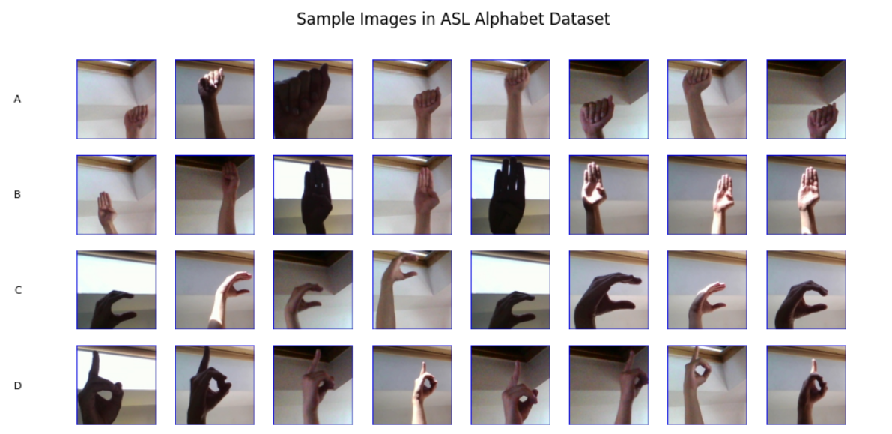
Dataset Overview | ASL Alphabet Dataset
fig.1

Slide 6
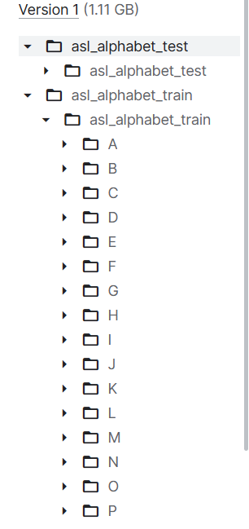
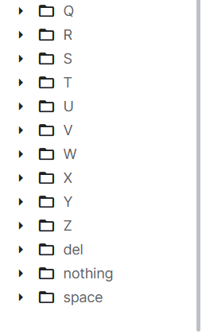
Dataset Overview | ASL Alphabet Dataset
The data set is a collection of images of alphabets from the American Sign Language, separated in 29 folders which represent the various classes.
The training data set contains 87,000 images which are 200x200 pixels. There are 29 classes as shown in fig.2, of which 26 are for the letters A-Z and 3 classes for SPACE, DELETE and NOTHING.
These last 3 classes are very helpful in real-time applications, and classification.
The test data set contains a mere 29 images.
fig.2.b
fig.2.a

Slide 7
SOURCES
Personal Images captured with the intent to create a dataset
COLLECTION METHODOLOGY
The dataset was created by Akash Nagaraj and made publicly accessible.
Expected Update Frequency
Monthly (Updated 6 years ago)

Slide 8
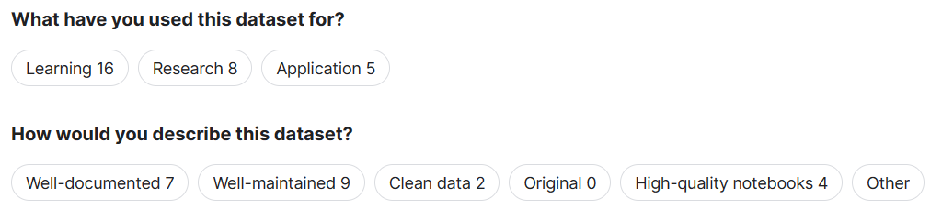
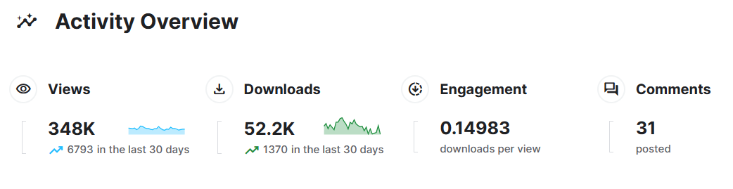
Diversity of the dataset
fig.3
fig.4

Slide 9
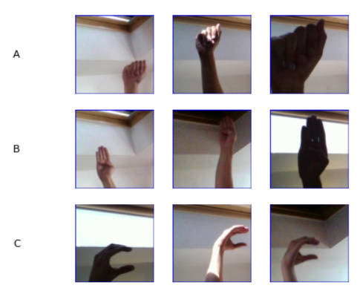
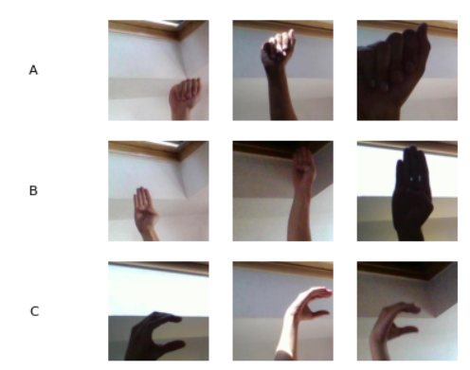
Data Preprocessing
Data cleaning | Border removal
fig.5
fig.6

Slide 10
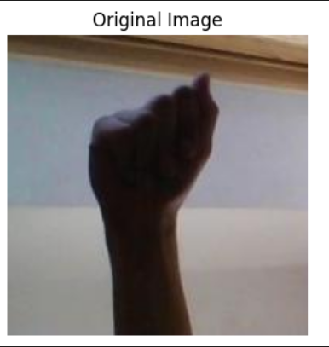
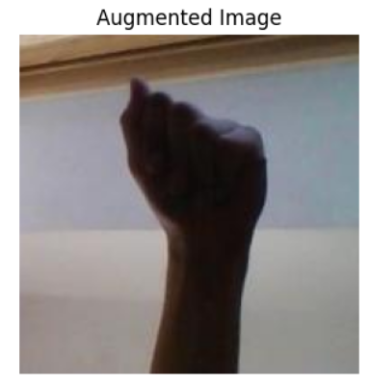
Data Preprocessing
Normalizing data | for fast computations
Data Augmentation | for more variations - both hands
fig.7
fig.8

Slide 11
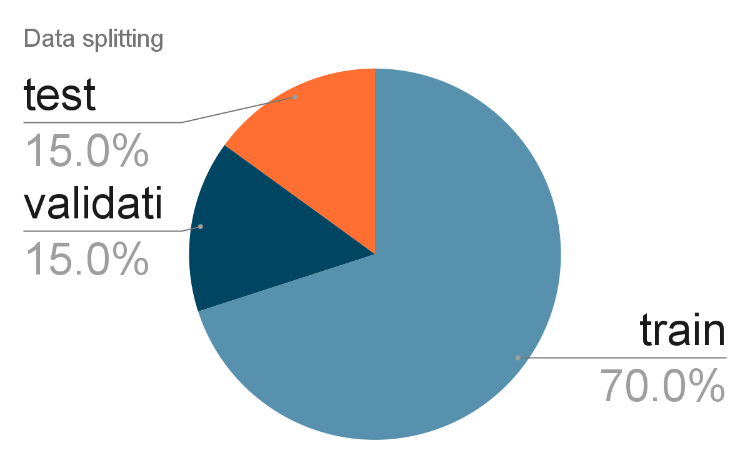
Data Preprocessing
train-validation-test split
chart.1

Slide 12
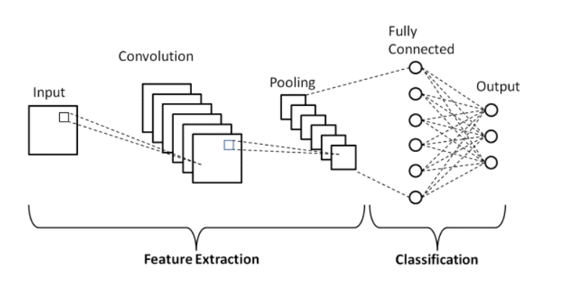
CNN Architecture .. why?
Translation Invariance
Computational Efficiency
Feature Retention
Dimensionality Reduction (Pooling)
fig.9

Slide 13
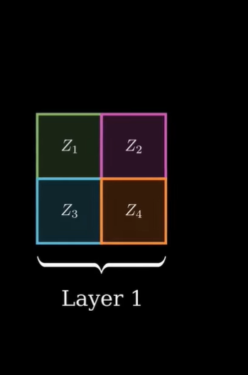
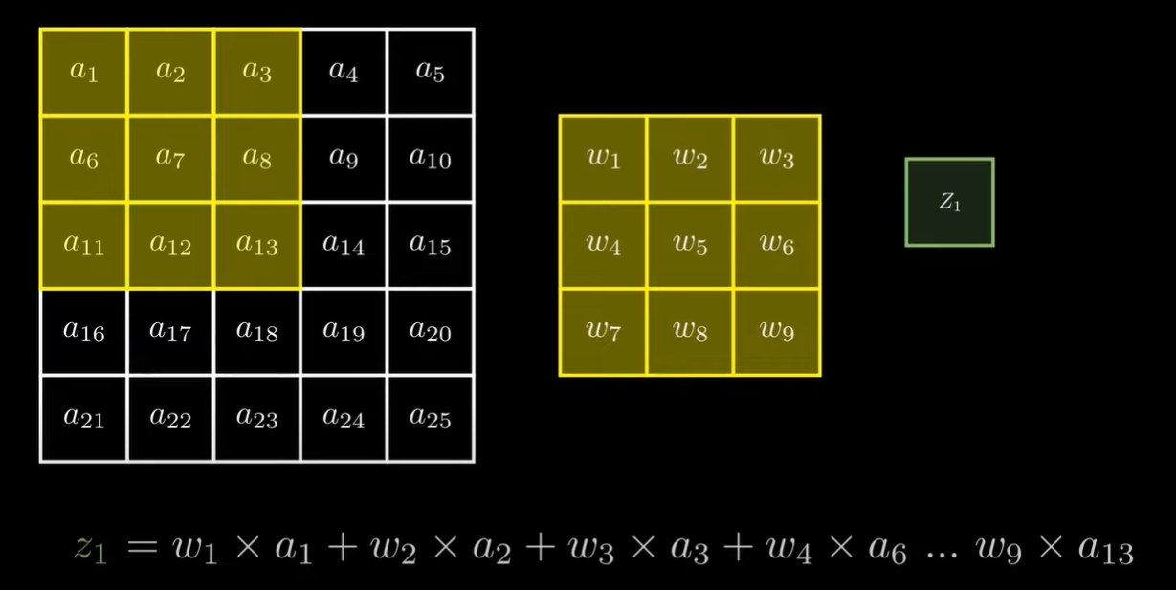
FeedForward Propagation
fig.10
and so on to get all values of the layer 1 feature map

Slide 14
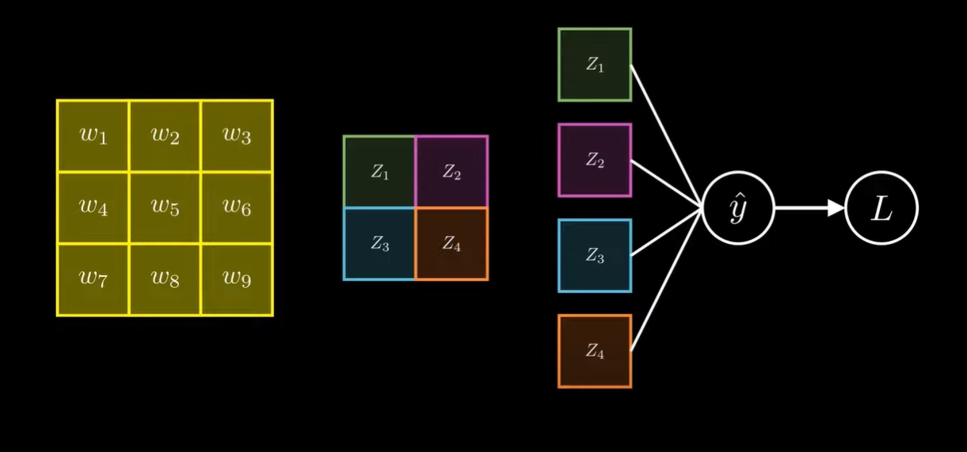
FeedForward Propagation
fig.11
flatten
prediction
loss

Slide 15
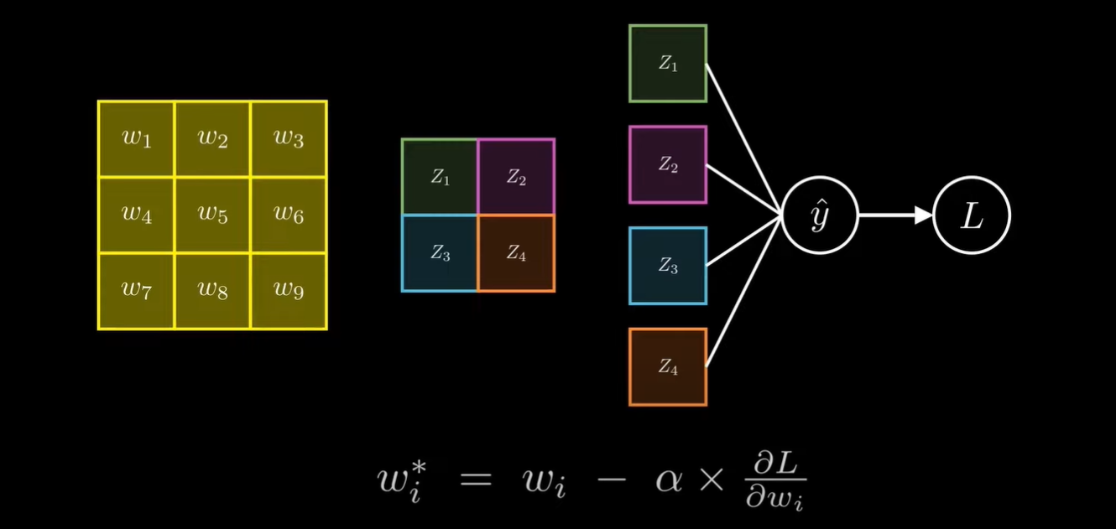
BackPropagation
fig.12
where alpha is the learning rate

Slide 16
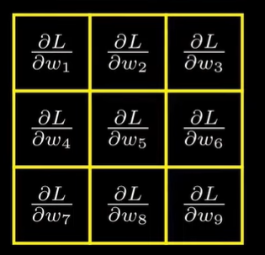
So, we put our derivative in a new kernel
More efficient !!
fig.13

Slide 17
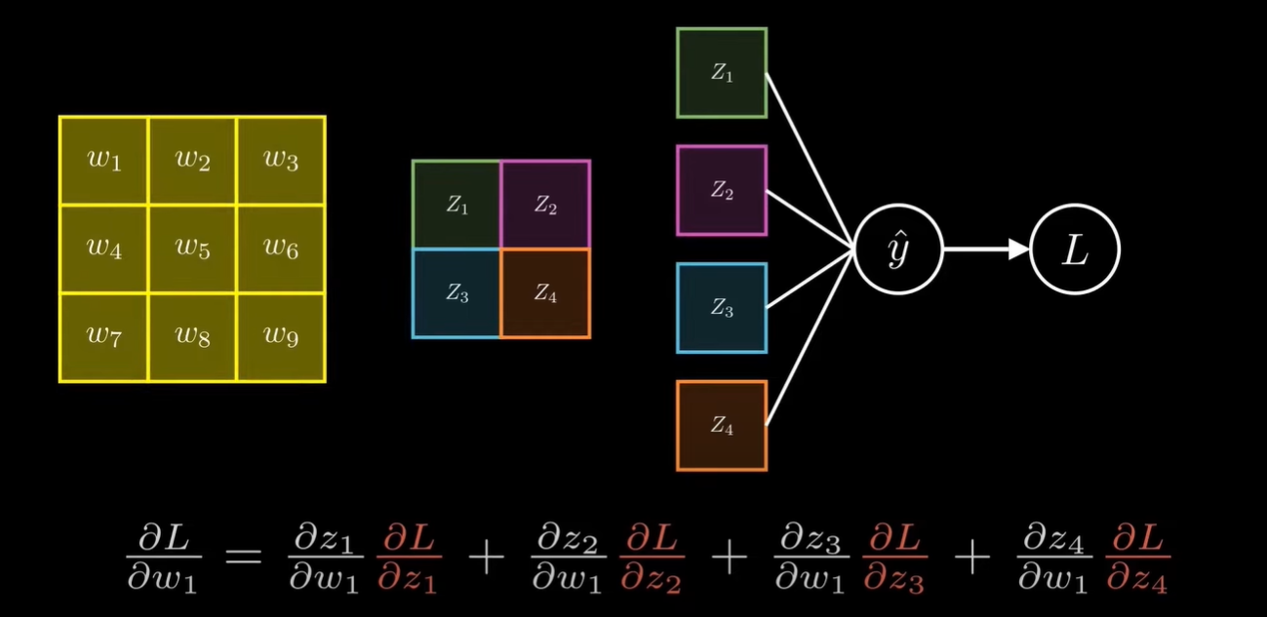
Lets see how to calculate one term … same for others!
L
fig.14

Slide 18
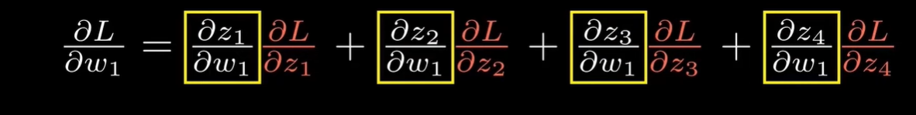

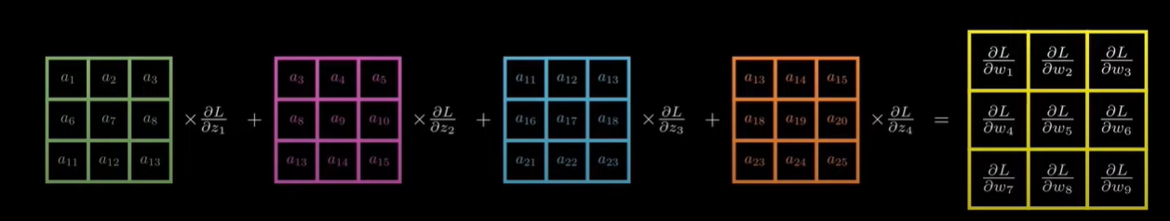
fig.15
Generally z = w1 x a + …..
Same for all other derivatives:
fig.16

Slide 19
Optimization algorithm
Adam
Adaptive Moment Estimation
Adaptive Learning Rate
Momentum
fig.17

Slide 20
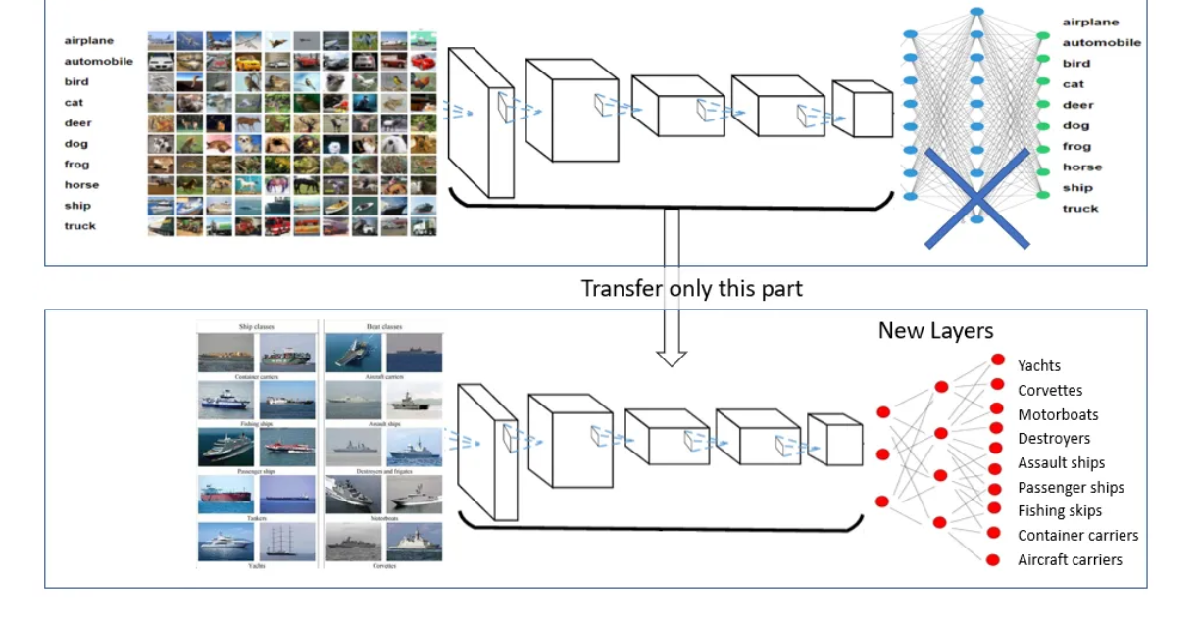
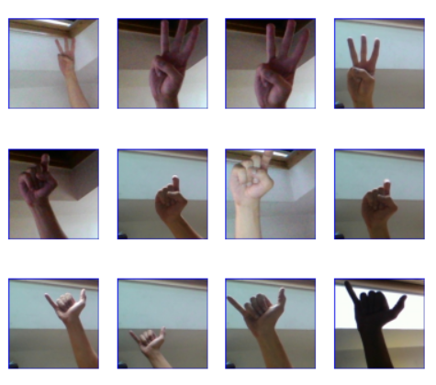
Transfer Learning
A
B
C
D
.
.
.
.
.
Z
.
.
freeze
fig.18

Slide 21
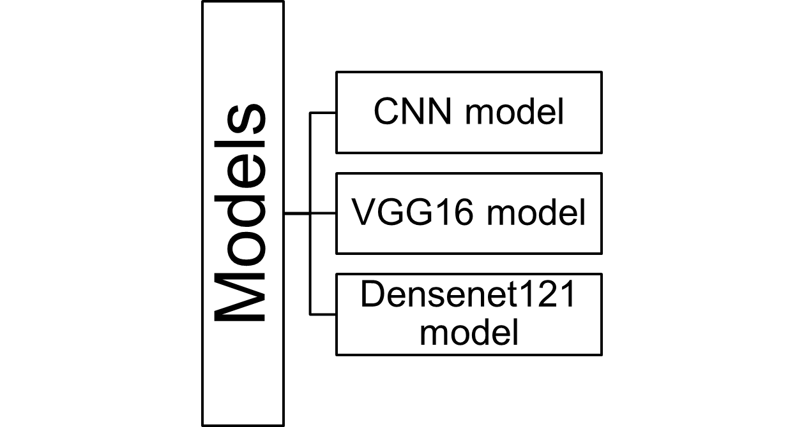
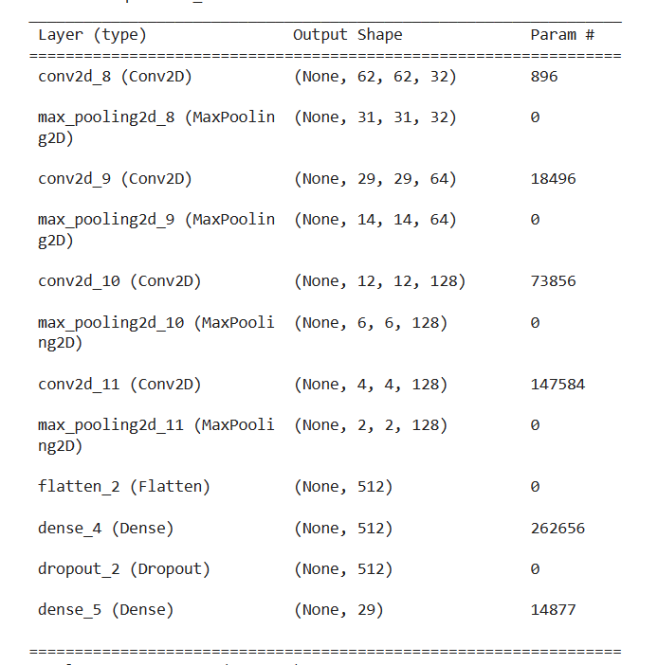
Experiment | what we have tried?
fig.20
fig.19

Slide 22
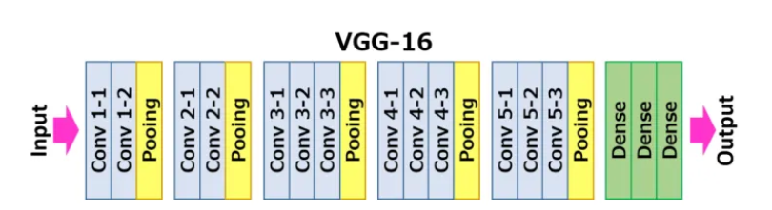
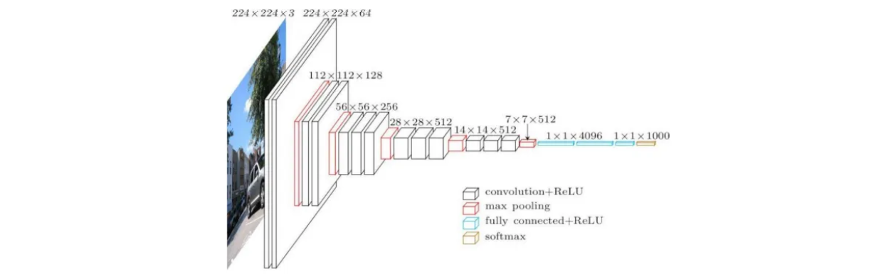
Pretrained models | VGG-16
fig.21
fig.22

Slide 23
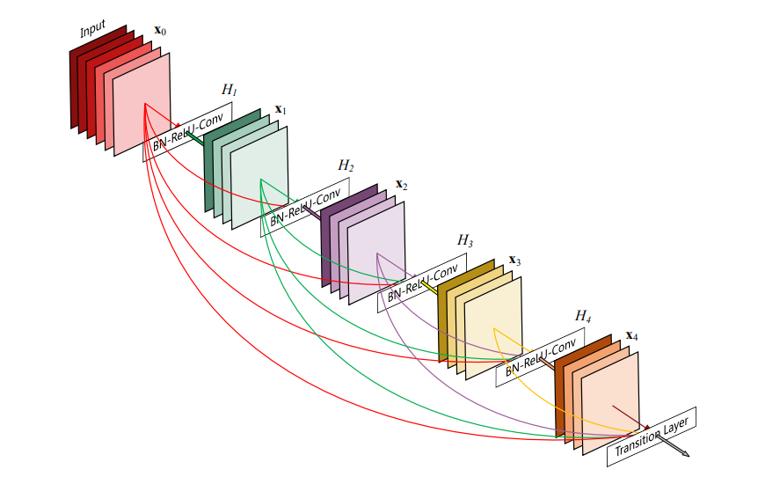
Pretrained models | DenseNet
dense connectivity
no vanishing gradient problem
fig.23

Slide 24
so, we have used validation dataset to choose the most accurate model . .
But how will these models be evaluated?

Slide 25
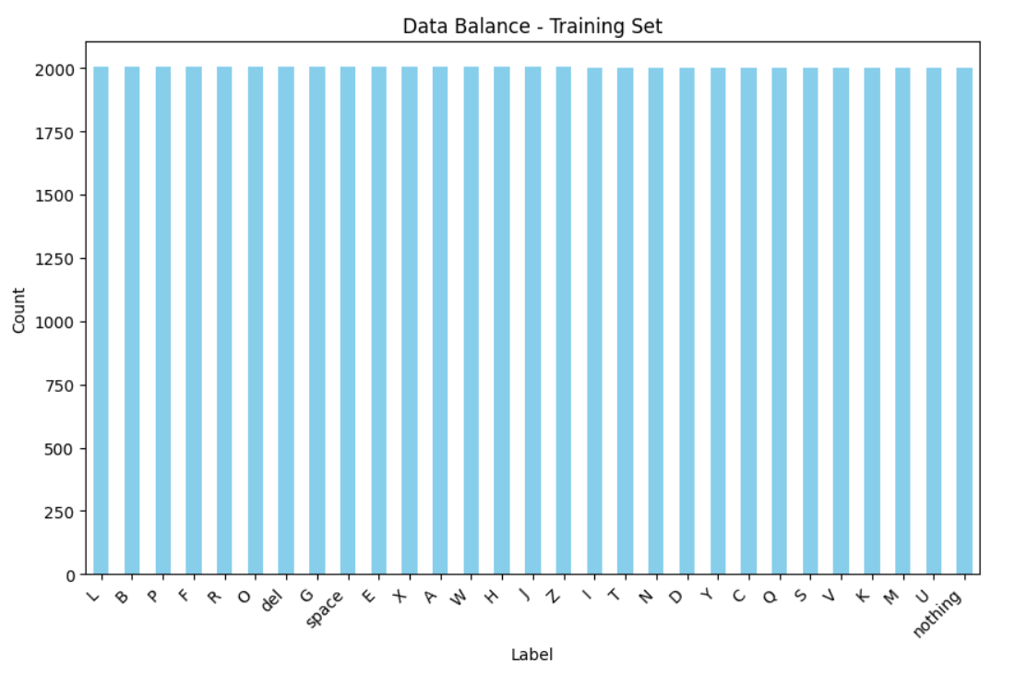
Balanced data!
so, we can use accuracy matric
we also used confusion matrix
chart2

Slide 26
Results
Quantitative Results
Qualitative Results
fig.24

Slide 27
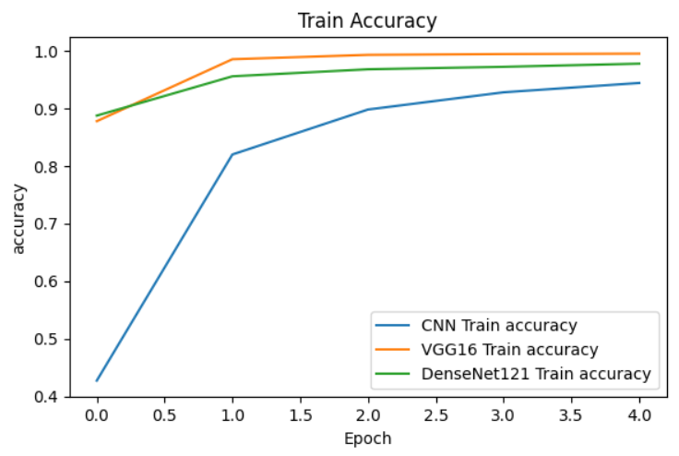
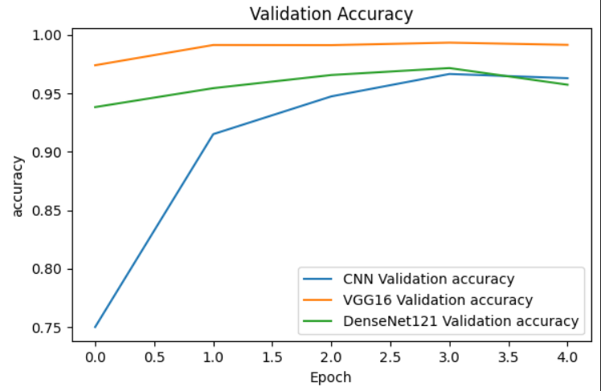
Accuracy
chart.3
chart.4
So, VGG16 has the highest accuracy! it’s our final model🎉🎉

Slide 28
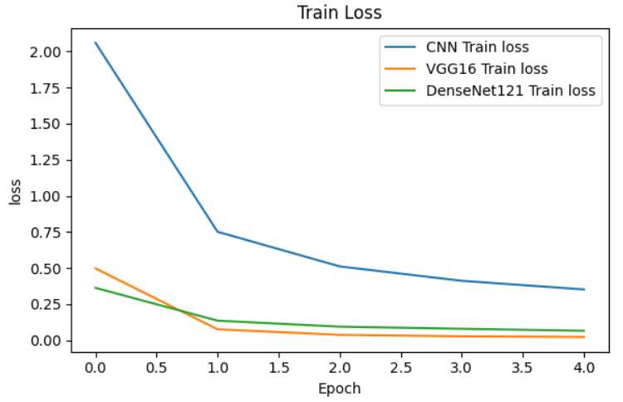
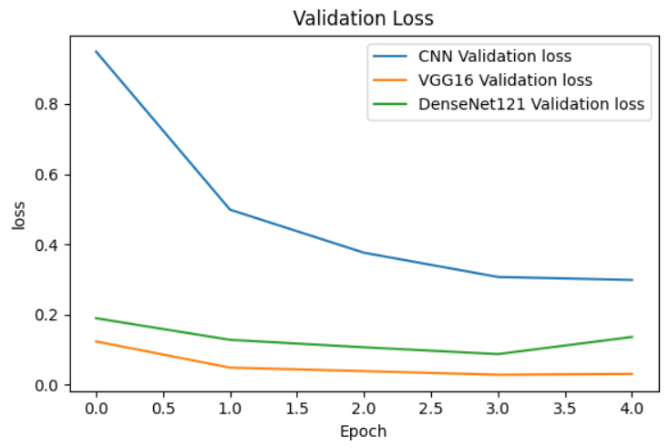
Loss
chart.5
chart.6

Slide 29
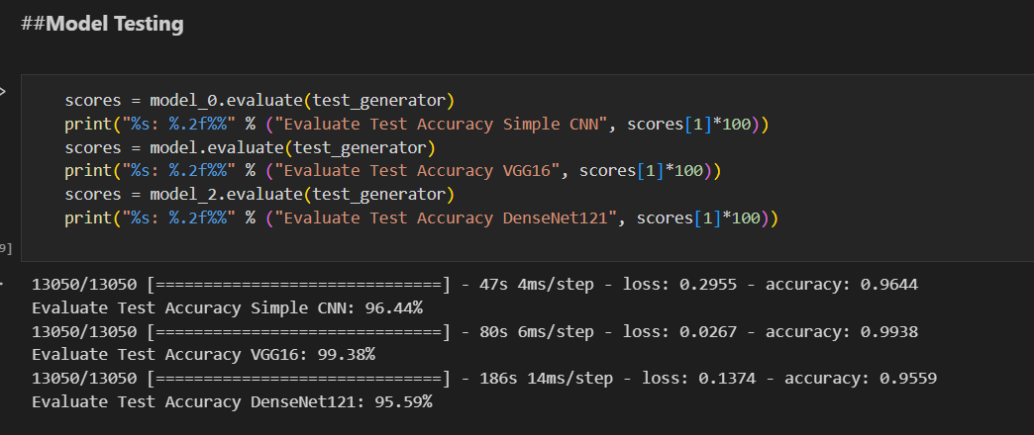
NoteBook Link:
https://drive.google.com/file/d/1-mtswXyRQDAPH4IZNlN5aOkbsqcZd5yN/view?usp=sharing
chart.24

Slide 30
Limitation:
trained on images
letter-level recognition
Future Work:
Address limitations of the current model.
Suggest potential enhancements.
Real-time Performance:
Optimize the model for real-time processing, ensuring low latency.
form sentences from finger spellings
Recognize more Gestures:
train model on large dataset of more labels

Slide 31
